Slide 1
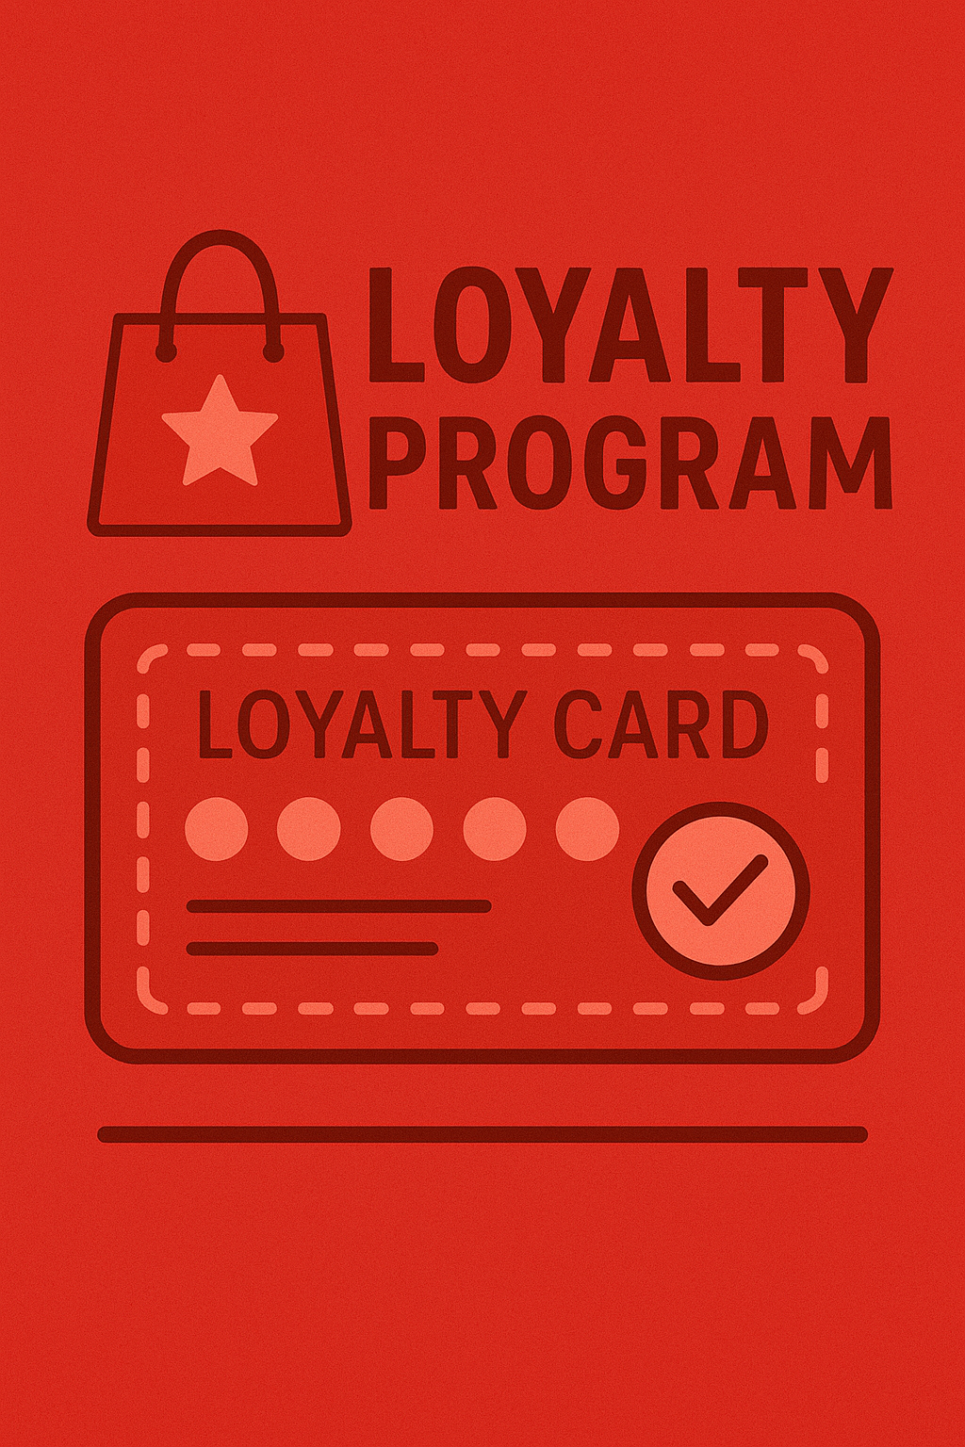

Points Based Loyalty
Concept Tests
RESEARCH REPORT | AUGUST 2025| KELLY PETERSON

Slide 2

1
Background & Approach
2
Summary of Recommendations
3
Concept Test Insights
Introducing Loyalty
Communicating Rewards & Progress
Loyalty “Hub”
TLDR
4
Next Steps
Image is what AI felt represented loyalty →

Slide 3
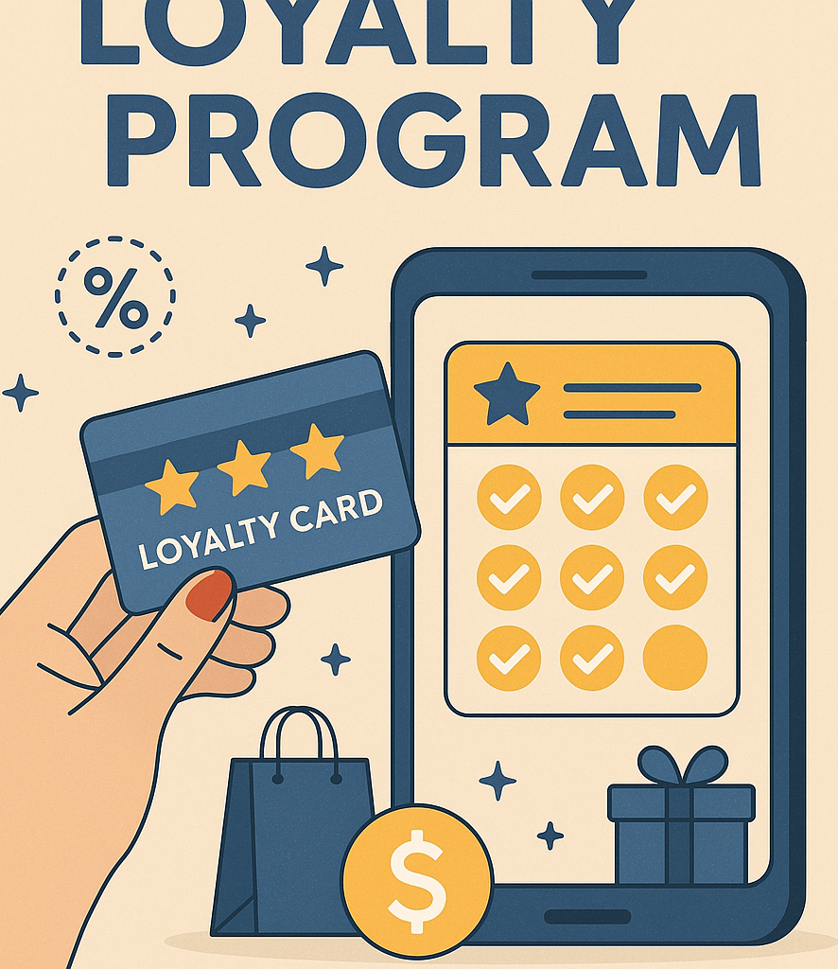
Background &
Approach

Slide 4


Background
Today there is over 150 million dollars worth of loyalty rewards left on the table. That is because current loyalty programs lack awareness and engagement among Cx today. Today’s structure has low recall due to the difficulty to find it in the app, inconsistent loyalty experiences across Mx and confusion between store rewards and one off promotions. To ensure future success of loyalty programs we must focus on simplicity and clarity.
Research Objective
This research is meant to identify the key areas of excitement, motivation as well as confusion and indifference around a points based loyalty program replacing store rewards.
Full Research Brief Here
Loyalty Vision Here
Methodology
30 min 1:1 interview with 7 Cx broken up into the two categories:
Leprechauns (sitting on gold) – Cx who have EARNED at least one store reward between 60 and 120 days ago but HAVE NOT REDEEMED at least one store reward in the last 60 days
Sisyphuses – Cx who made reward progress in the last 60 days but have NOT YET EARNED a reward

Slide 5
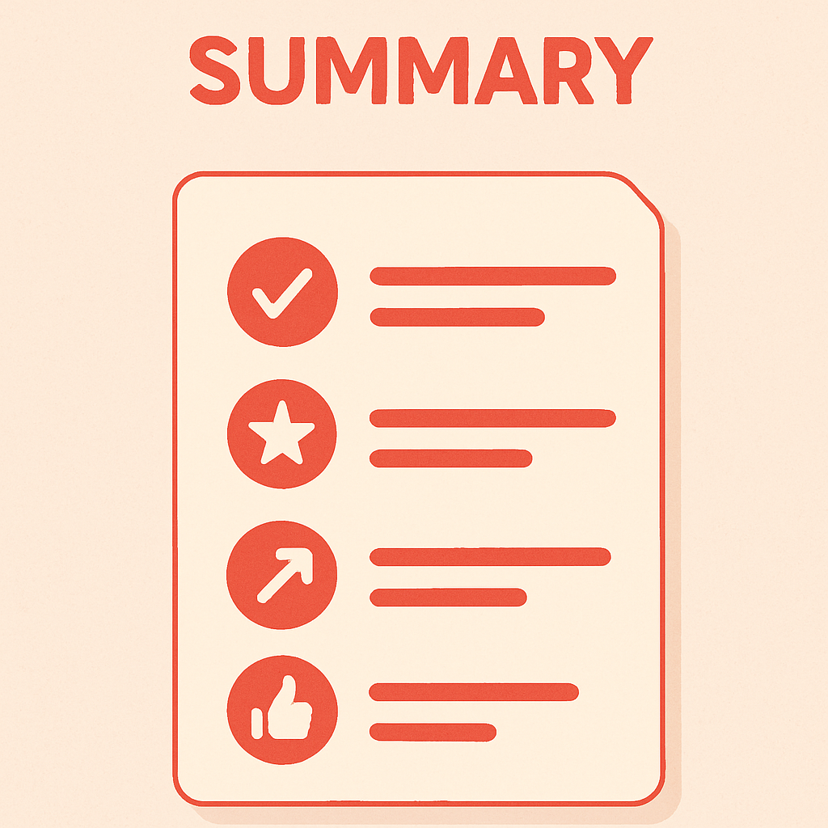
Summary of Recommendations

Slide 6




Remove the guesswork
Let Cx decide
Keep it simple
Be clear
Improve discoverability with onboarding popup on store page. Do not expect Cx to notice and explore content around loyalty or points.
Early interactions need more help, provide homepage updates right after opt-in or after major milestones
Celebrate unlocked rewards by alerting Cx in their homepage feed. Don’t expect Cx to regularly check rewards, especially in their first interactions.
Don’t ship the org–don’t expect Cx to already know dine out vs. pickup vs. delivery. Don’t expect Cx to know all about the MeTab. Guide and piecemeal information along the way.
Let Cx opt-in but after they have ordered from a store at least 3 times. Pace out when store pop ups come up alerting Cx of a store’s loyalty- too much at once will overwhelm.
Consider a future auto-opt in after Cx have unlocked a few rewards and are familiar with how it works.
Consider a place where Cx can opt-in to multiple stores on one screen once they have unlocked a few rewards and are familiar with how loyalty works.
Consider an opt out of all loyalty. For Cx that continually opt out, don’t keep pestering them.
Replace confusing descriptions & reduce text significantly:
In-store vs. delivery
Join now
Be more upfront with what Cx need to do:
No additional sign up required
No additional cost/fees
No changes required to ordering experience
No additional comms
Don’t try to fit loyalty card visuals into the apple wallet look, instead focus on ensuring Cx can quickly differentiate between verticals vs.stores and points/rewards available
Focus on unlocking the first reward balance on store page header. Bigger milestone’s can be communicated later.
Be upfront with what a reward is. We can’t expect Cx to sign up for something if they don’t know what they will get out of it.
Communicate the value of rewards. Don’t send Cx hunting through menus to find out how much a reward costs if they want to order it.
Don’t expect Cx to do the 10-1 math everywhere– just do it for them.
Work closely with DashPass to avoid continued confusion. DashPass’s role in loyalty should be crystal clear and easily explained by Classic and DashPass Cx. Maybe there’s an opportunity for DashPass to allow for some DoorDash level points use.

Slide 7

Concept Test Insights
1. Introducing Loyalty
2. Communicating Rewards & Progress
3. Loyalty “Hub”

Slide 8
1. Introducing Loyalty
“
I get a monthly credit and I want to say it's either $5 or $10 and I can't, honestly remember….I definitely have seen 5% off if you spend X amount of dollars, I'm assuming that's DoorDash (loyalty), so I have used that.
Today, Cx struggle differentiating between ALL of the ways to save
Store rewards
DashPass discounts
Chase credits
Promos
”
Colleen, Sisyphus
“
I guess only because we were talking about rewards, I can see the get $5 off DashPass orders, right?
”
Julianne, Leprechaun
Research Recommends: The inclusion of points will help Cx differentiate between rewards & promos. It is critical that DashPass and loyalty teams work together for a clear and consistent system to avoid confusion between benefits and rewards.

Slide 9
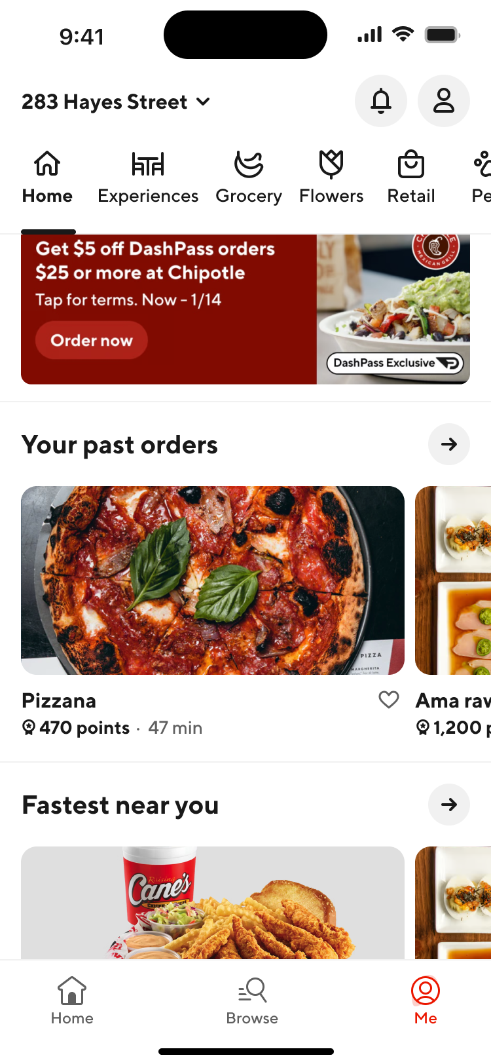
1. Introducing Loyalty
Introducing points on the homepage without context is confusing for Cx
Without prompts or guidance, participants didn’t notice points in the store footer
Many Cx assumed ordering from the Rx would get them 470 points towards a larger loyalty program
Cx want to know what the points mean; its worth in dollars, what it gets you, and if you have them or not
Research Recommends: Do not introduce points in the metadata below the image, Cx are unlikely to notice it and it will provide more questions than answers

Slide 10
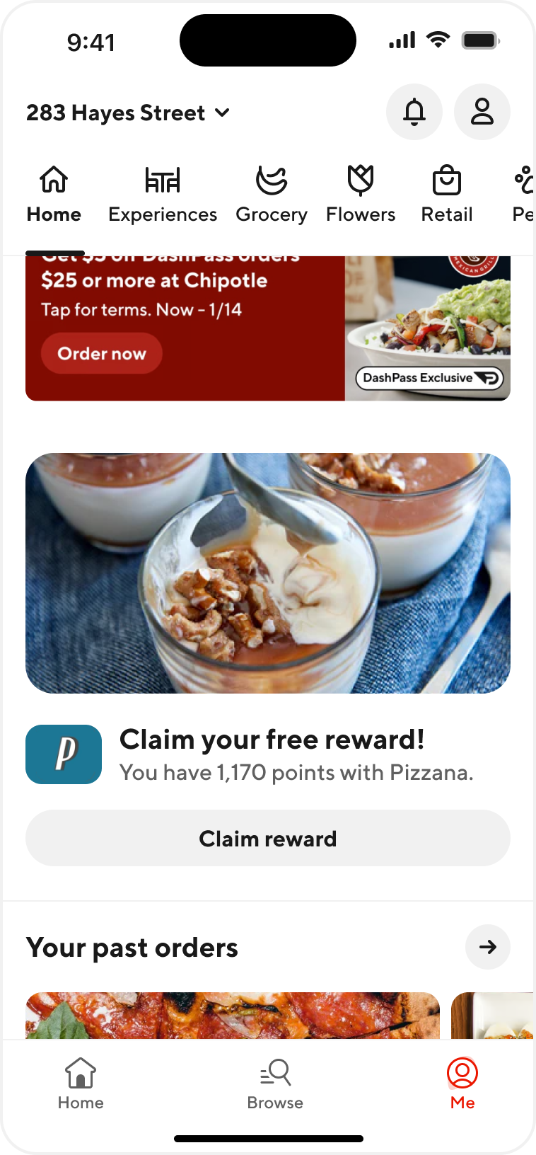
1. Introducing Loyalty
Seeing a reward on the homepage is exciting and likely to lead to conversion at that Mx
All Cx indicated they would likely visit the store page and were likely to place an order
Two Cx noted they would be a little confused how they got points and would be skeptical that they had to do something extra to get the reward
Research Recommends: Experimenting with this with existing store rewards program to see impact on awareness and conversion.

Slide 11
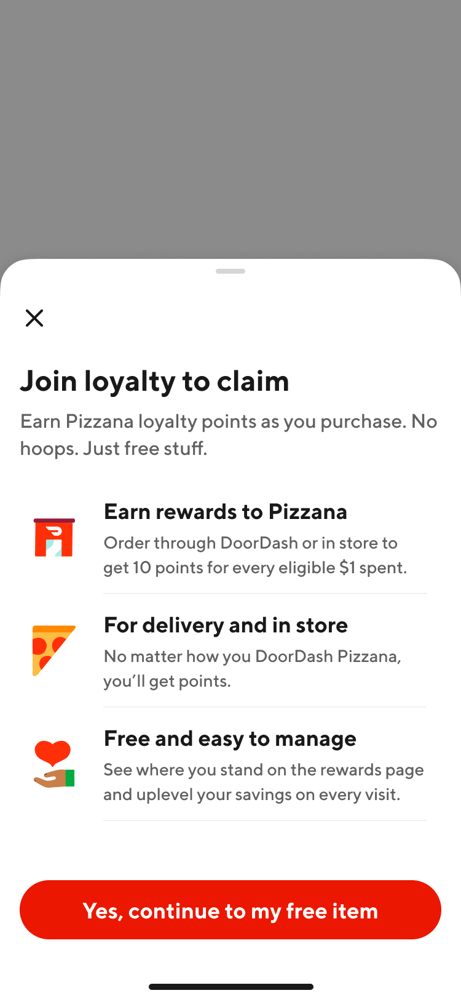
1. Introducing Loyalty
Store page popup is helpful, but needs to be simplified and clarified
This page was critical to help Cx understand that it was store based loyalty vs. DoorDash loyalty
Cx did not understand delivery and in-store; e.g. is it pickup or the stores loyalty program?
Cx felt we should really highlight the “free” part more
Half of Cx expected to have to fill out a form to join the loyalty program, for many this might deter them from joining
Some Cx felt there is too much text and they are unlikely to read
Some Cx felt they need to know the available rewards to feel motivated to join
Research Recommends: Work closely with content to clarify and simplify. Make sure to highlight free, no added information and potential rewards.

Slide 12

1. Introducing Loyalty
Cx prefer to opt-in at an earlier state to know they are a part of the loyalty process…but feel that learning about a reward is exciting
Without opting in Cx feel they are automatically enrolled in every Rx and that is not valuable to them
Cx like the idea of knowing that they are earning rewards
Cx feel they need to order 1-2 times before they know if loyalty will be meaningful at a Mx
Research Recommends: Experiment with opt-in for stores visited 3+ times. For Cx that do not opt-in provide opt-in opportunity when rewards are available. After high intent Cx opt in to a series of stores consider creating an opt-in for every story I order from X times option.

Slide 13
1. Introducing Loyalty
Regardless of how we communicate the availability of loyalty, Cx are not 100% satisfied because it is not at a “DoorDash” level
“
See in my mind I was thinking that I was getting a like this is like that Pizza Place's bucket, and my points that I got and I earned in that they're all going in that Pizza Place's bucket. And then I click out and I go to my other bucket. I was thinking I was getting a DoorDash bucket, like a big old pail of all the places that I've ordered and they're all in that bucket. Am I not getting that bucket? Am I just getting separate buckets?
”
Tyler, Sisyphus

Slide 14
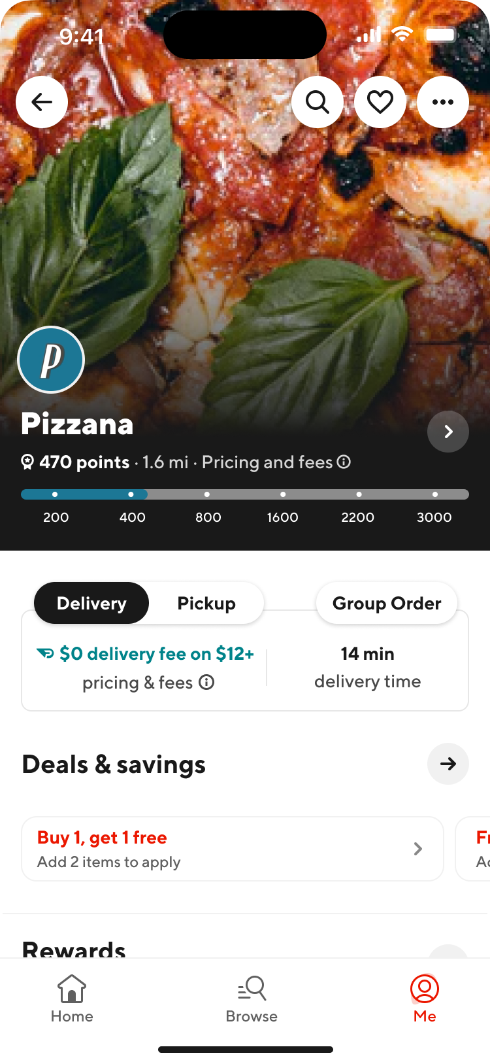
2. Communicating Rewards & Progress
Cx reacted positively to seeing loyalty points separated from USI, but they have a few questions
Some Cx though that the upper limit of points was the goal they had to reach to achieve a reward
Cx did not miss the information that was originally in this spot and felt they had everything they needed to know because it was a restaurant they had ordered from before
Research Recommends: Continue to break out rewards from USI; make milestones more clear in the visual

Slide 15
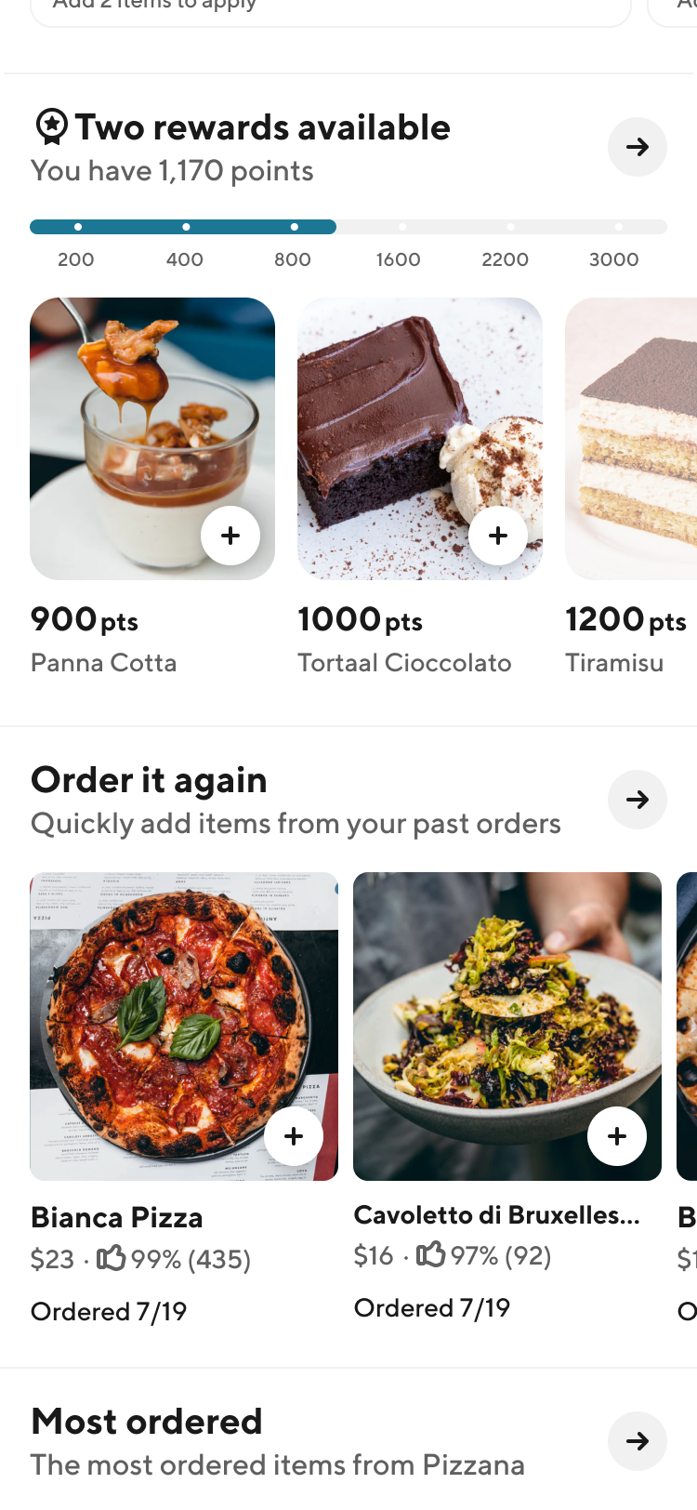
2. Communicating Rewards & Progress
Most Cx were excited to see the rewards as a section of the store menu
Cx felt the rewards and what is needed to achieve them were super clear in this visual
Many Cx indicated this felt similar to other Rx based loyalty programs that they use
Some Cx felt it was too busy and did not want to see the items they had not unlocked yet
Half of Cx felt really motivated by Tiramisu
One Cx felt they needed to know the monetary value of the reward items
Research Recommends: Experiment with this carousel for existing store rewards programs. If a Rx offers Tiramisu, we should recommend they include it as a reward :)

Slide 16
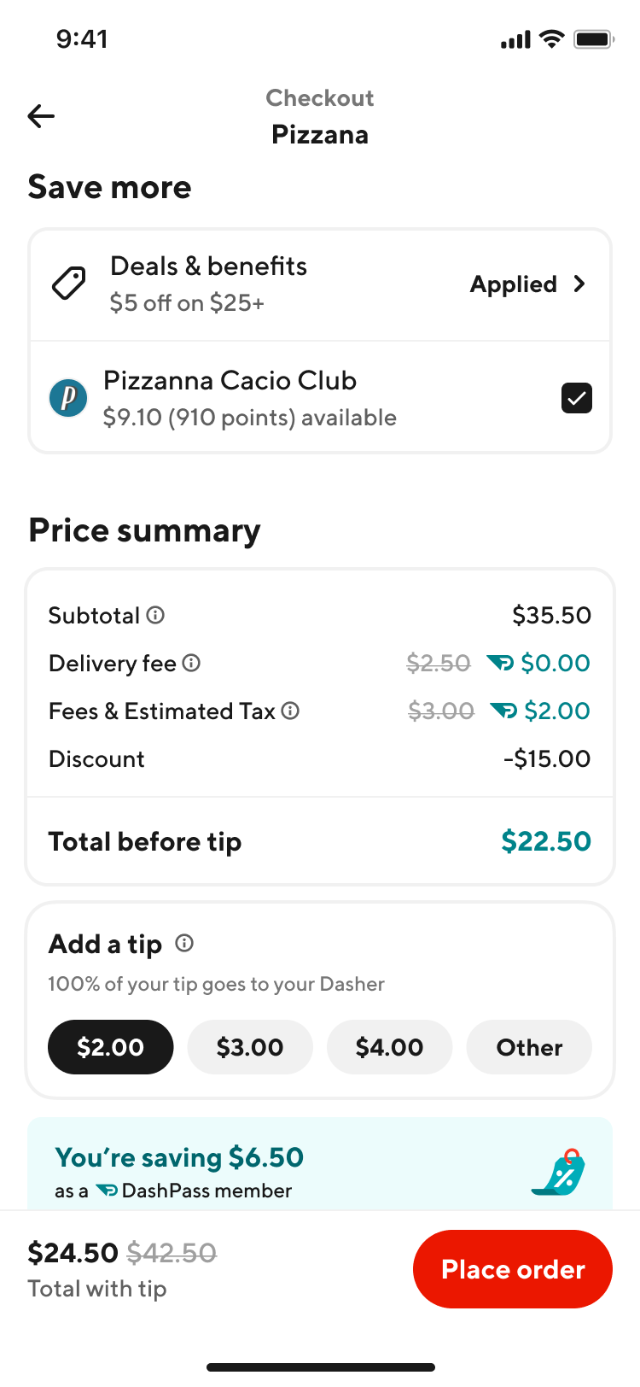
2. Communicating Rewards & Progress
Cx like the ability to select or unselect a reward at checkout
Cx want to be able to “change their mind” on using their reward after they build a full cart
One Cx took the $9.10 to be the cost of the reward item on the menu regularly vs. the cost of the points
Research Recommends: Continue pushing on this format for applying rewards. There should be further exploration around how value should be communicated (the cost of the item vs. the points)

Slide 17
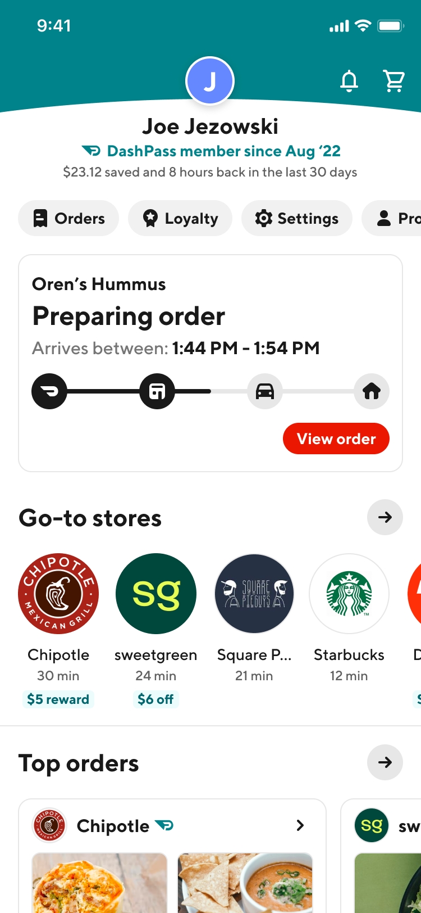
3. Loyalty “Hub”
The MeTab is a reasonable place for loyalty but not all Cx are aware of it
Half of Cx were aware of the MeTab but indicated that they only use it for previous orders
Cx felt it made sense on the MeTab even if they aren’t necessarily used to visiting it
All Cx had no idea that they can already access store rewards on the MeTab
A few Cx mentioned they would want to see reward information on the homepage, particularly if they reached a major milestone
Research Recommends: The MeTab will work to house this but work has to be done to build awareness of the MeTab and loyalty’s location there. Additionally we may consider including reward status on the homepage for a short period after opting-in and then when major milestones are reached.

Slide 18
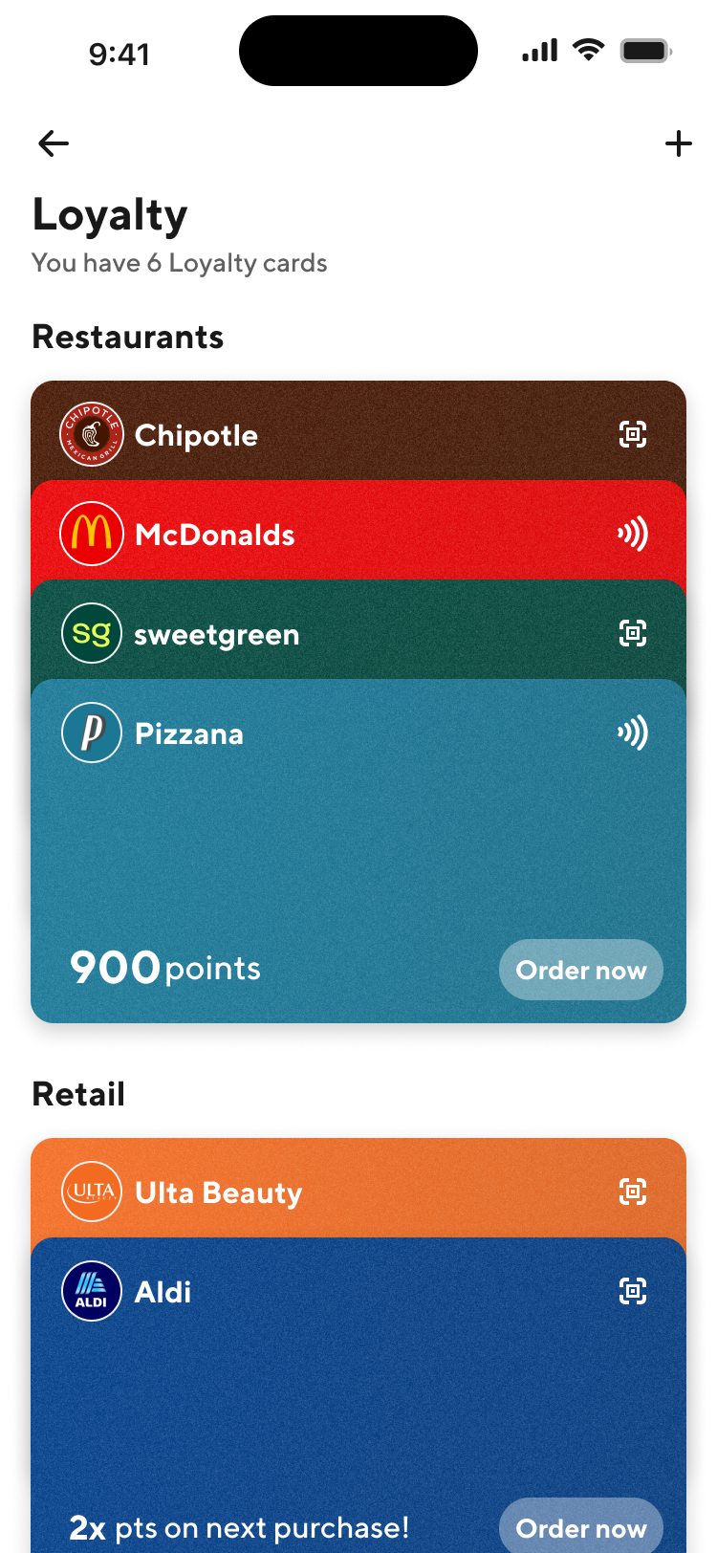
3. Loyalty “Hub”
The promo wallet looked clean and familiar but was not necessarily “helpful”
What worked:
Different colors to quickly see different Rx
Simple, no information overload
Breaking out retail and Rx separately
What didn’t work:
Cx don’t feel loyalty cards meet the same use case as the Apple Wallet
It felt like an unnecessary step
Cx want to be able to see points quickly; you need to click around to find out where you might have a reward
Research Recommends: Rethinking the design of this to move away from cards while keeping color and simplicity. Do not include all reward detail, but some sort of points status for each.

Slide 19
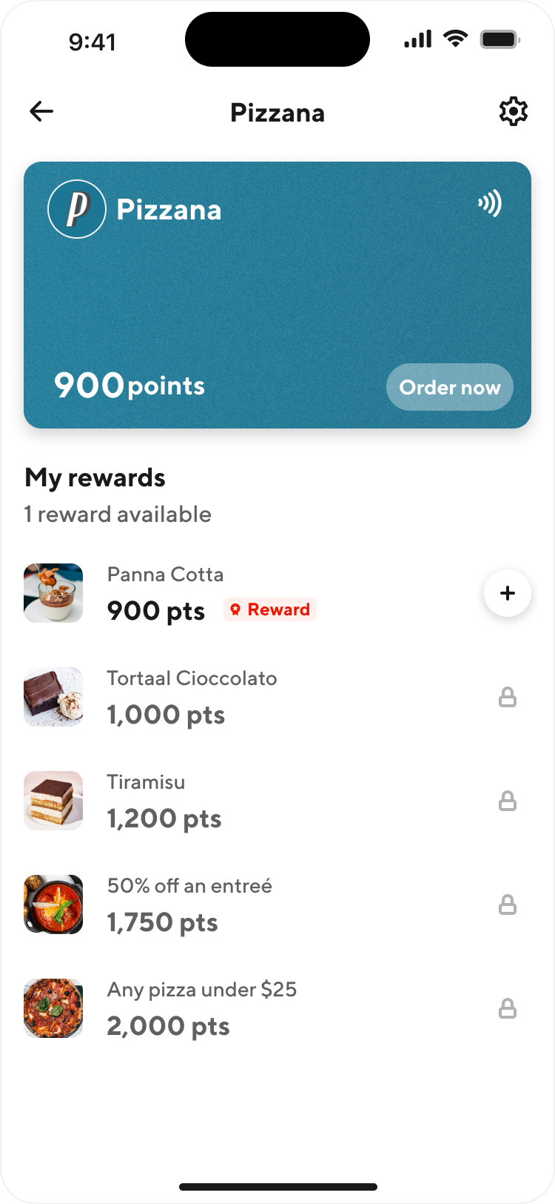
3. Loyalty “Hub”
Cx LOVED the individual store summary pages
Research Recommends: Ship it!

Slide 20
Important note: Some Cx will just not care about loyalty
“
“
If I order off the restaurant like how much but how much it would cost right but if I know I really want that panna cotta like that's what I'm craving I'm gonna get it even if I only have 470 points I'm not obviously I don't have enough points to get it for rewards but I mean if that's what I really want I'm gonna buy it.
So basically like the frequency that you're ordering you're just like you're not unlocking rewards that's not worthwhile for you…..Yeah, it'd be cool. I'd probably order more from a store if it was like a really solid place. But then a lot of stores also have just like new customer deals or I don't know, like one-time deals and I mean I like saving money.
”
”
Kelly, Leprechaun
Harsh, Leprechaun

Slide 21

Next Steps

Slide 22
Next steps
JJ to make updates prior to design review
Kelly to work with JJ and Chantal to identify if research is needed alongside future experimentation
Kelly to work with JJ and Chantal to identify if additional Mx research is needed

